Slide 1
Tutorial 1 Extra Notes + Lab 1 Solution
How to OOP

Slide 2
Aims of OOP
Easy to add new features
Break code into more manageable chunks (more on this during next week’s tutorial)
Increase reusability

Slide 3
Scenario
Want to simulate life
Plants and Animals

Slide 4
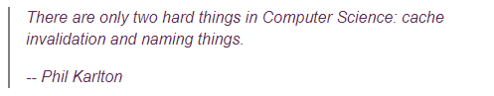
Names
Think very hard about names
Names of classes, variables, and methods
In 6 months time, can you understand your own code easily?

Slide 5
First Step: Identify Nouns
Plants and Animals

Slide 6
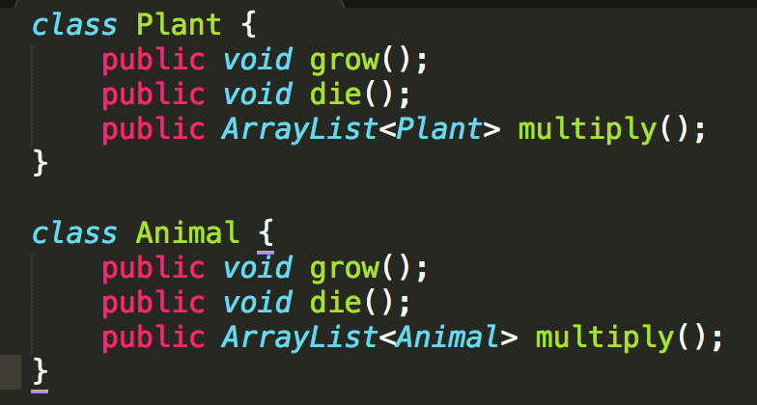
Create classes

Slide 7
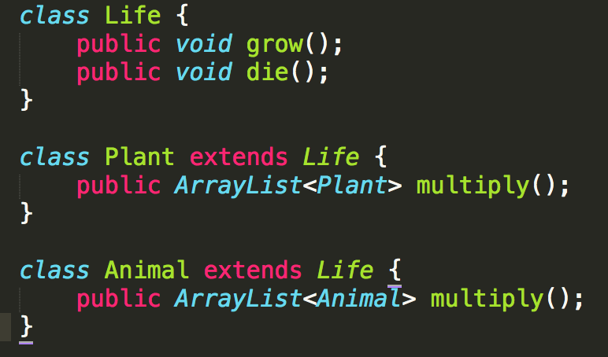
Combine common elements
D.R.Y. (Don’t Repeat Yourself)

Slide 8
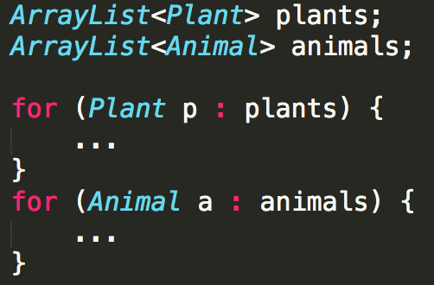
(Possible) Main Program Loop

Slide 9
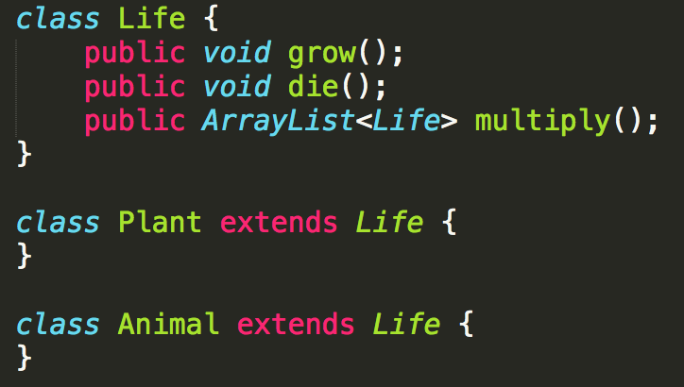
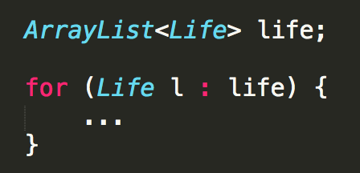
We can do better
Use inheritance to make things easier

Slide 10
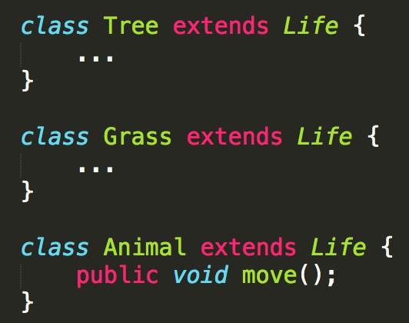
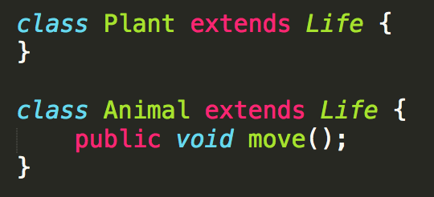
Add more methods
It is okay to have classes that have no difference from their parents
vs
Plan ahead, do work now to avoid more work later
╳
✔
Notes:
Example: Want to add plant-only methods in the future

Slide 11
Class Diagram
Life
Animal
Plant

Slide 12
New Feature
Want to simulate immortal life (i.e. God, i.e. )
How to model?
https://www.reddit.com/r/onetruegod/

Slide 13
Class Diagram
Maybe?
Life
Animal
Plant

Slide 14
Class Diagram
Maybe?
Life
ImmortalLife
Animal
Plant

Slide 15
Class Diagram
Life
Actually…
MortalLife
Animal
Plant

Slide 16
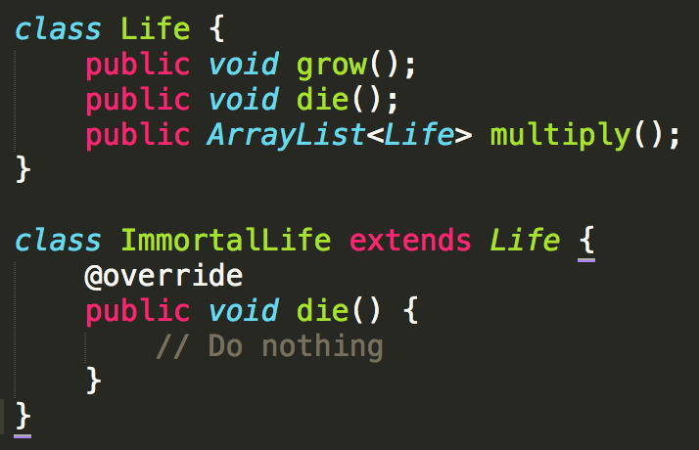
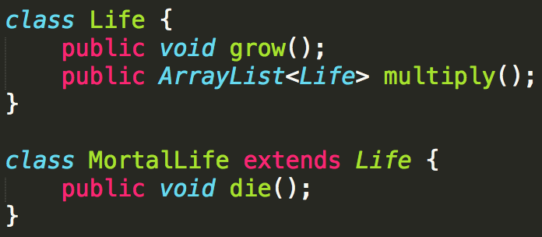
Why?
\
vs
“Child” classes must have the same functionality as their parents
They can have more functions or do things differently, but the method must still do as described

Slide 17
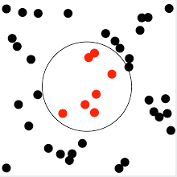
Now Consider Lab 1…
In this problem, you are given a set of points on a 2D plane, and a unit disc (i.e., a circle of radius 1). We want to place the disc so that it covers as many points as possible.

Slide 18
Now Consider Lab 1…
In this problem, you are given a set of points on a 2D plane, and a unit disc (i.e., a circle of radius 1). We want to place the disc so that it covers as many points as possible.

Slide 19
Now Consider Lab 1…
In this problem, you are given a set of points on a 2D plane, and a unit disc (i.e., a circle of radius 1). We want to place the disc so that it covers as many points as possible.
Classes: Point and Disc (or Circle)

Slide 20
Break down the problem
Classes: Point and Circle
Need to do: Given a circle, how many points are contained within it?

Slide 21
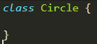
Break down the problem
Classes: Point and Circle
Need to do: Given a circle, how many points are contained within it?

Slide 22
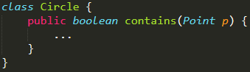
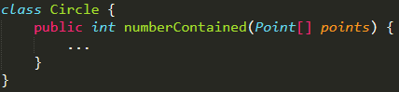
Break down the problem
Classes: Point and Circle
Need to do: Given a circle, how many points are contained within it?
or

Slide 23
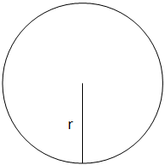
Break down the problem
Classes: Point and Circle
How to represent a circle?

Slide 24
Break down the problem
Classes: Point and Circle
How to represent a circle?

Slide 25
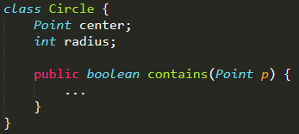
Break down the problem
Classes: Point and Circle
How to represent a circle?

Slide 26
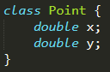
Break down the problem
Classes: Point and Circle
How to represent a point?
A point is just a set of coordinates

Slide 27
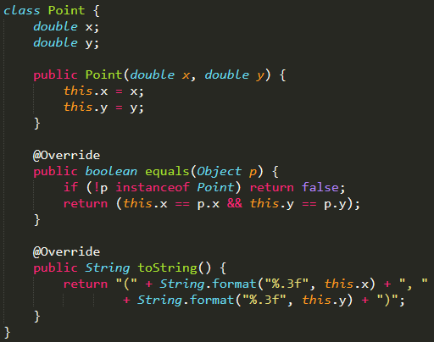
Break down the problem
Add constructors (and do the same for Circle)
And other methods like toString(), equals()

Slide 28
Level 1 done!

Slide 29
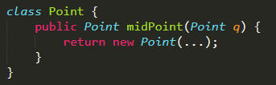
Next problem
How to find midpoint?
Either:
p.midPoint(q)

Slide 30
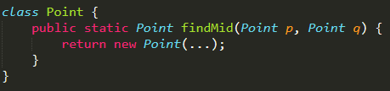
Next problem
How to find midpoint?
Or:
Point.findMid(p, q)
Note that both are methods of Point because they are related to it
It doesn’t make sense to calculate this outside of Point

Slide 31
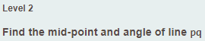
Continue solving problems
Level 2 class design:
Point
Point(double x, double y)
midPoint(Point q)
angleTo(Point q)

Slide 32
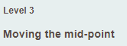
Continue solving problems
Level 3 class design:
Point
Point(double x, double y)
midPoint(Point q)
angleTo(Point q)
move(double angle, double distance)

Slide 33
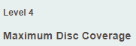
Continue solving problems
Level 4 class design:
Point
Point(double x, double y)
midPoint(Point q)
angleTo(Point q)
move(double angle, double distance)
Circle
Circle(Point center, int/double radius)
static findIntersecting(Point p, Point q)
contains(Point p)

Slide 34
Keeping orderly code
Circle.findIntersecting(Point p, Point q)
By level 3, most of your code is probably in Main
By level 4, it makes more sense to have it in Circle

Slide 35
Plan ahead
Proper Level 3 class design:
Point
Point(double x, double y)
midPoint(Point q)
angleTo(Point q)
move(double angle, double distance)
Circle
Circle(Point center, int/double radius)
static findIntersecting(Point p, Point q)

Slide 36
Plan ahead
Level 4 class design:
Point
Point(double x, double y)
midPoint(Point q)
angleTo(Point q)
move(double angle, double distance)
Circle
Circle(Point center, int/double radius)
static findIntersecting(Point p, Point q)
contains(Point p)

Slide 37
Do something like…
Point center
int radius
double x,y
Circle
Point
contains(Point)
move(angle, direction)
findIntersecting(Point,Point)
midPoint(Point)
angleTo(Point)

Slide 38
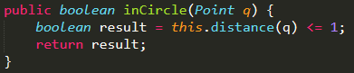
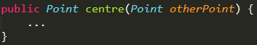
Some mistakes this lab
Meaningless method signatures
“in circle” but provide a point?
Centre of what?
Lesson: Use descriptive names & context
These methods make more sense in a Circle context

Slide 39
Some mistakes this lab
Using classes as namespaces / function organisers (Not OOPing at all)
A few people stored points as double[][] then pass as data into a Point instance
Very hard to understand your own code / got stuck
Probably tried to add on to existing code at level 2 instead of changing it
Lesson: Design your program before you start coding

Slide 40
In Summary
Don’t start coding straight away
Read the whole problem first
Then design your classes before you start coding
Program from the POV of another person

Slide 41
Want more like this?
You are welcome in my tutorial ☺
Friday 12-1pm
This week’s extra topic: How to write readable & manageable code

